Slide 1
Blessing of dimensionality using low-dimensional data
Hong Ye Tan
Joint work with: Carola-Bibiane Schönlieb, Subhadip Mukherjee, Junqi Tang
arXiv:2408.06996
GSK.ai PhD Symposium
24/09/24

Slide 2
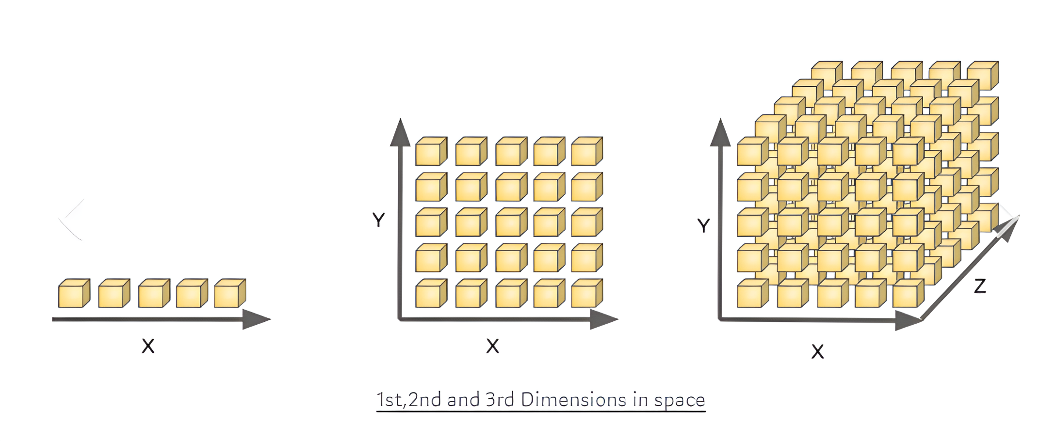
Background: Dimensionality
Dimensionality = difficulty
Canonical example: sampling
    Complexity scales exponentially with
    dimension
    Optimisation, nearest neighbours,
    metric learning, data visualisation…
The curse can be slightly lifted depending on additional constraints
  Optimising non-convex function: exponential in dimension (random search)
  Convex and bounded: linear (centre of gravity)
  Convex and smooth: bounds using e.g. Lipschitz constant

Slide 3
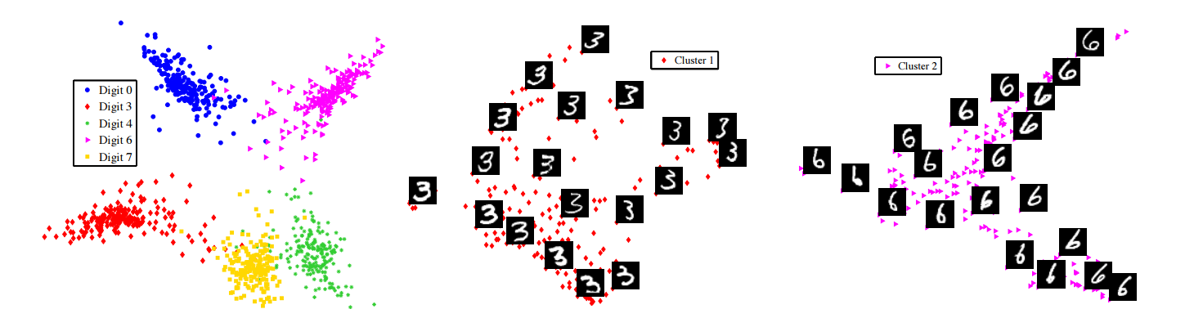
Background: Manifolds
Not all hope is lost!
Manifold Hypothesis: Natural data is intrinsically low-dimensional.
    Original motivation: statistical tools still work when we have high dimensions and relatively little data, when they are not supposed to
    a.k.a. blessing of dimensionality, concentration of measure.
    Then dimensionality reduction methods work and give us nice visualisations

Slide 4
Project goal
Low Statistical Complexity
Useful Functions
Intuition: in lower dimensions, it should be easier to approximate, say, Lipschitz continuous functions with a simple class of functions.
We want to determine how difficult it is to approximate a:
  Sufficiently useful class of functions
  with a simple class of functions
⚠ Purely theoretical
Generalisation
Simple?
– notion of statistical complexity

Slide 5


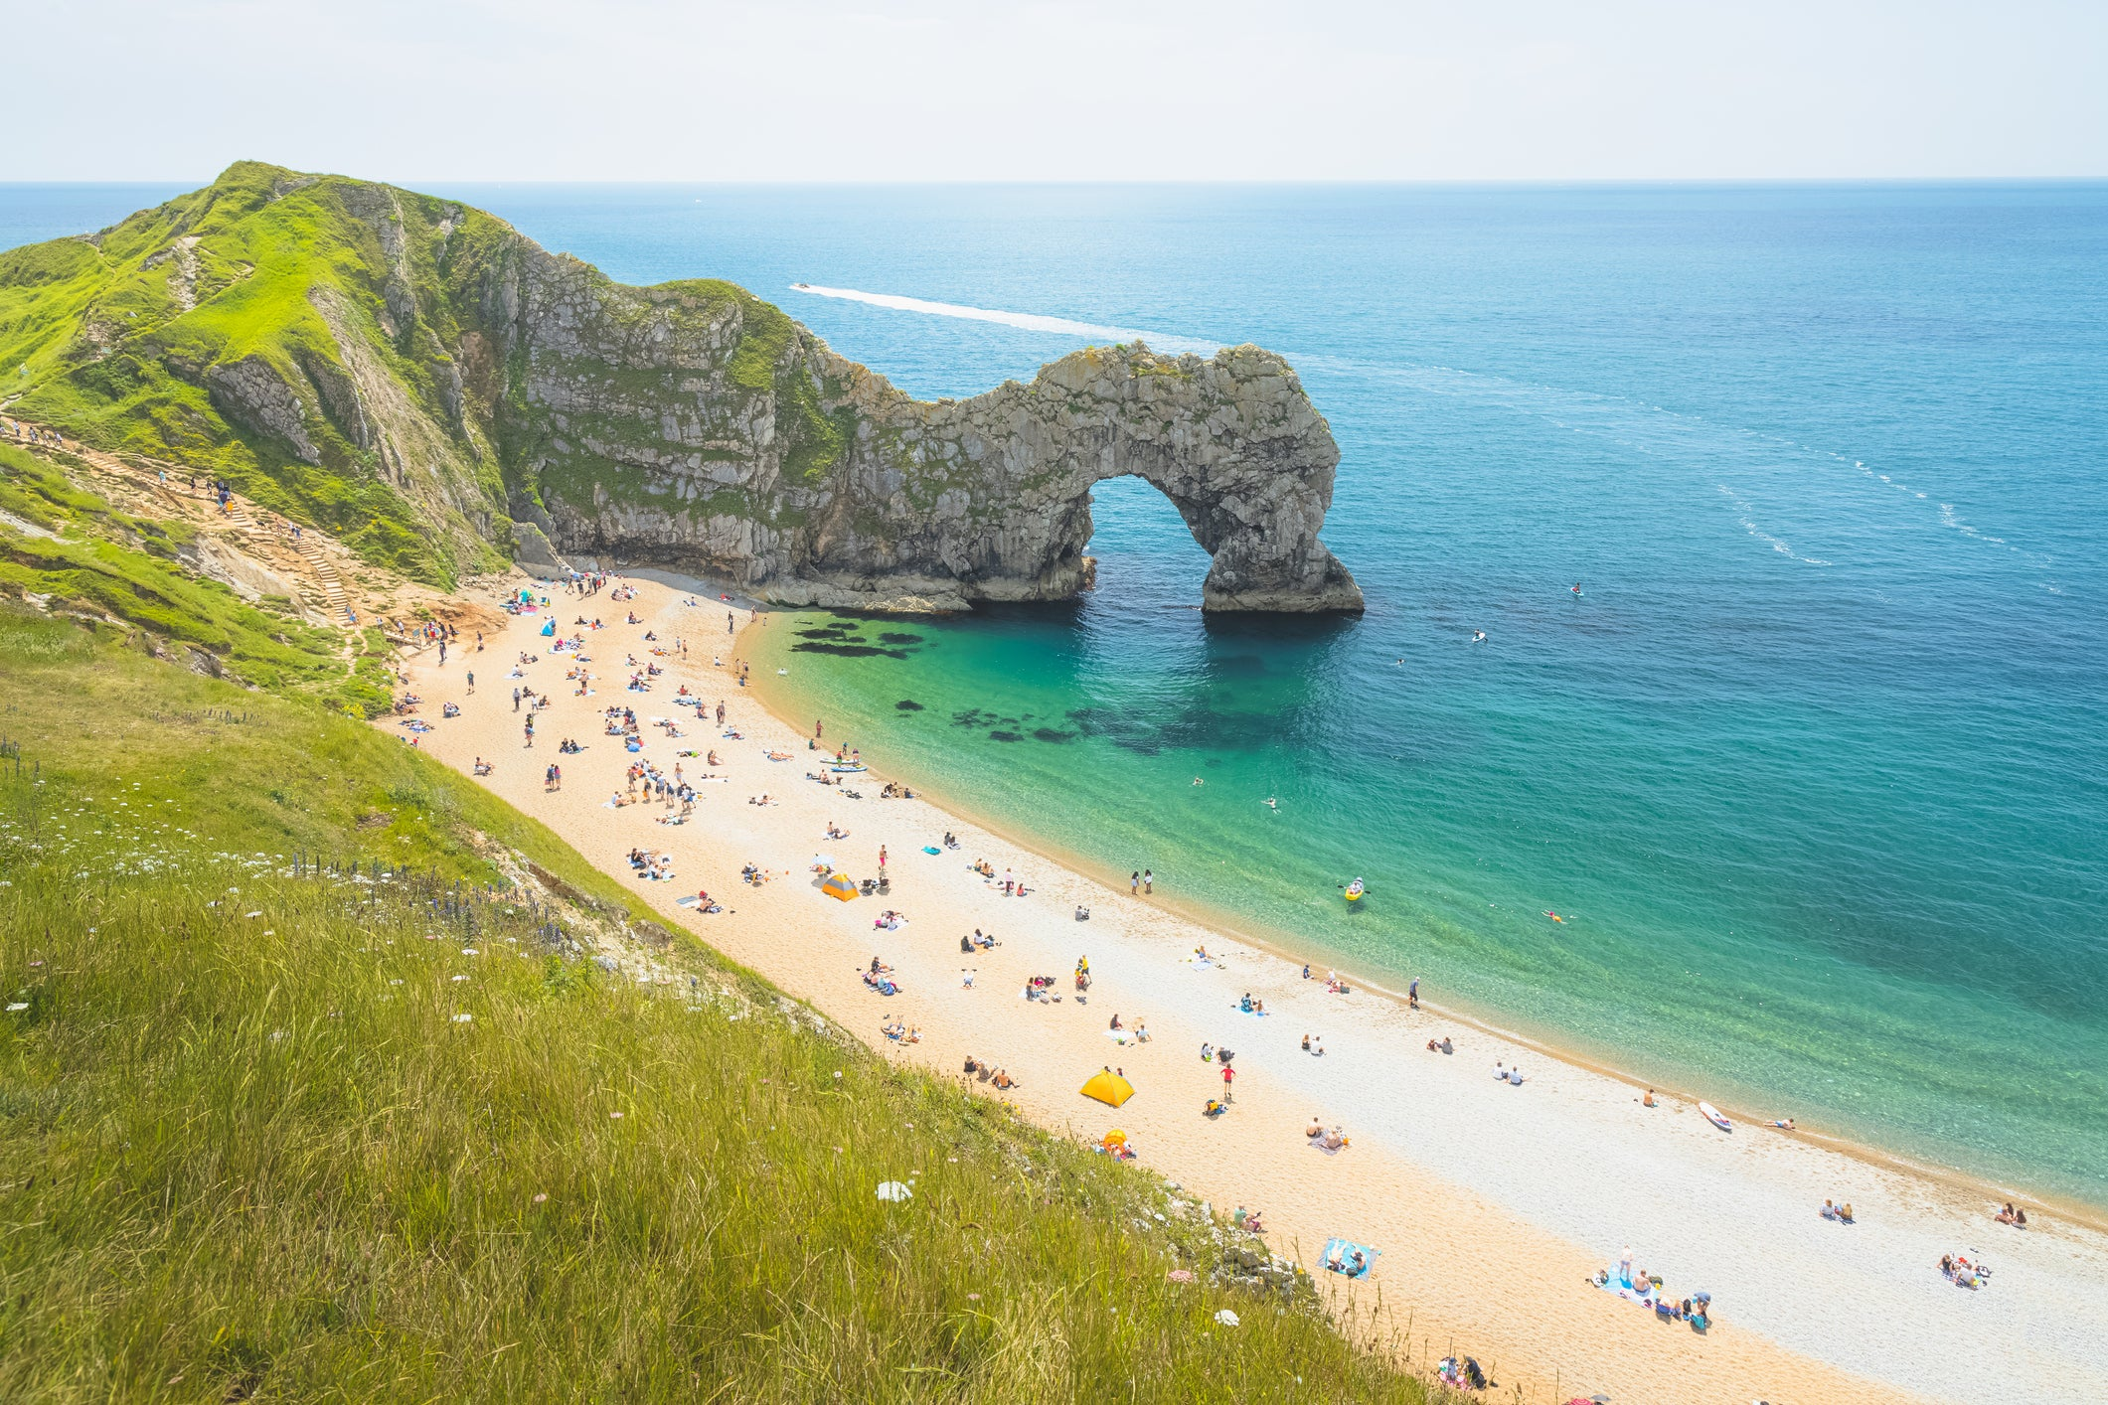
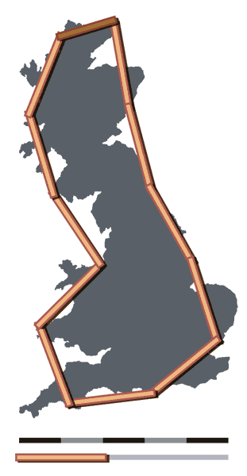
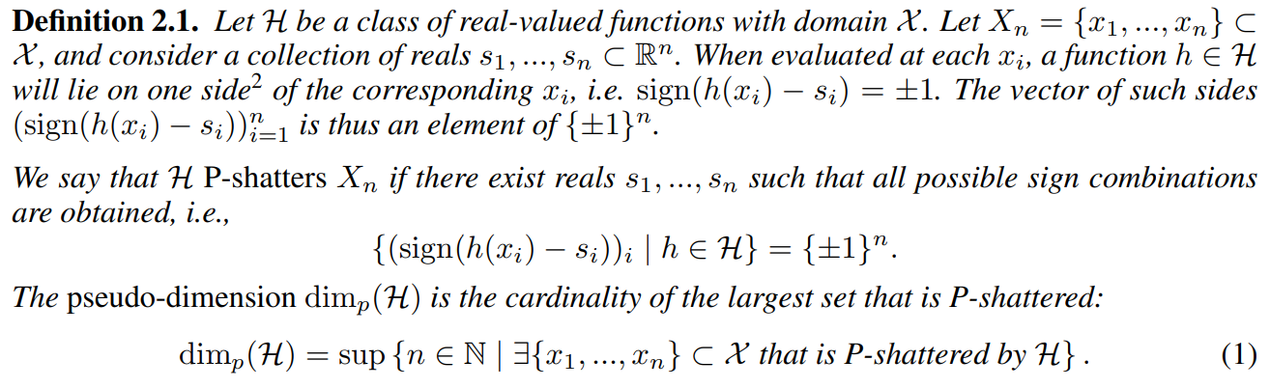
Function class complexity
Maths
British Coastline
Sobolev space
functions with derivative
  Infinite dimensional, pretty nasty
  We need to approximate (a bounded version) with simpler functions
“Pseudo-dimension”
  Measure of statistical complexity
The British coastline
  Very grainy around the edges
  We need to measure this with
  a coarse set of tools: rulers
  See: coastline paradox
How long your rulers are

Slide 6
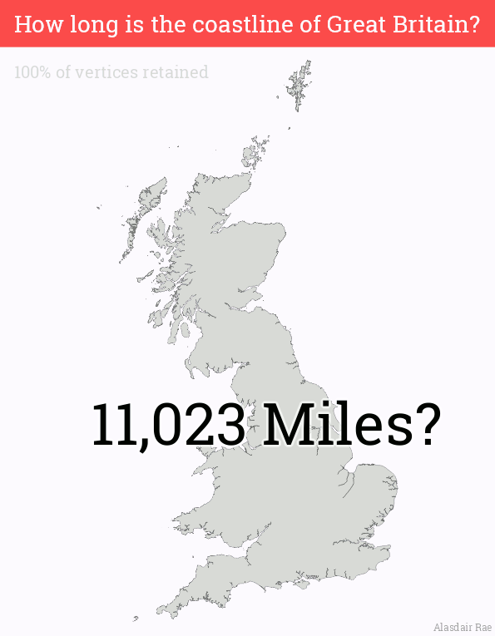

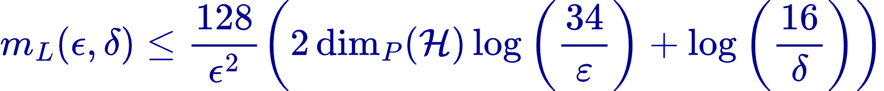
Why statistical complexity? Sample complexity
Maths
British Coastline
Low complexity
lower sample complexity
Longer rulers, fewer points needed to measure the coast
The number of samples required to be within
of the true risk with probability at least
is bounded above by:
Directly related to better generalisation
  Simpler description is less prone to error
A. Rae, https://www.statsmapsnpix.com/2016/08/how-long-is-coastline-of-great-britain.html

Slide 7

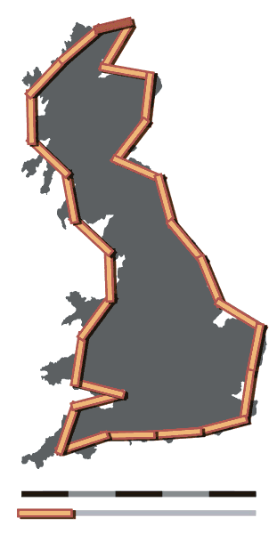
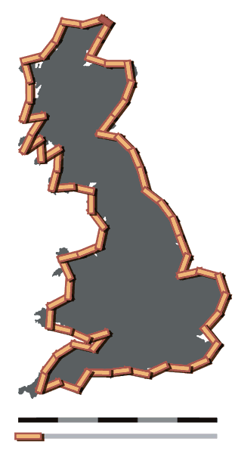
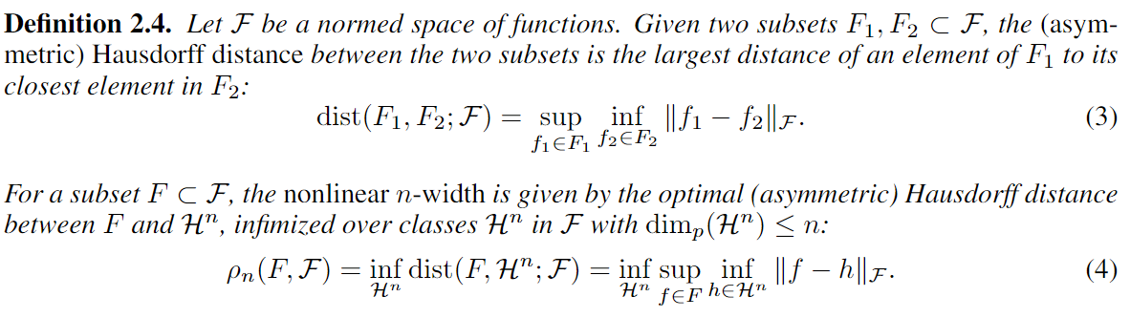




Approximation complexity
Maths
British Coastline
Approximation with bounded pseudo-dimension functions
  Given a maximum pseudo-dimension, the non-linear width of a function class
  is the best approximation with such limited pseudo-dimension classes
Approximation with long rulers
100km rulers
50km rulers
  Nonlinear width: approximation error
  Denoted , depends on max complexity
Length:
~2800km
~3400km
  Error from using long rulers
CC BY-SA 3.0, https://commons.wikimedia.org/w/index.php?curid=642220

Slide 8
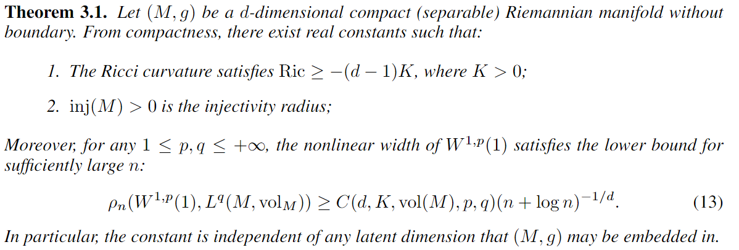
Main result
Standard assumptions
Proof is constructive
  Construct a particular subset of that is hard to approximate using low-complexity function classes
  Uses approximation theory, differential geometry, functional analysis

Slide 9



Classical comparison + interpretation
Us:
$d$ dimensional manifold
Unavailable on manifolds
Related to curvature
Classical:
$D$dimensional hypercube
We lower bound the optimal approximation error in terms of the allowed statistical complexity and the intrinsic dimension
As the statistical complexity increases, this error decreases
The rate at which this error decreases is dependent only on the intrinsic dimension (and properties of the manifold)

Slide 10

Summary
We demonstrate that function approximation is provably difficult, but only in the intrinsic dimension.
  Increasing statistical complexity to approximate a function class yields slower rates as the dimension increases.
  Our result is completely independent of any embedding dimensions
Implications: Well-structured data is crucial for good training
Open questions:
  Extensions to higher Sobolev derivatives (requires better manifold approximation techniques)
  Other manifold properties, e.g. reach, condition, that may have
  better bounds
arXiv:2408.06996

